Slide 1
Motivation: CV Use cases

Slide 2
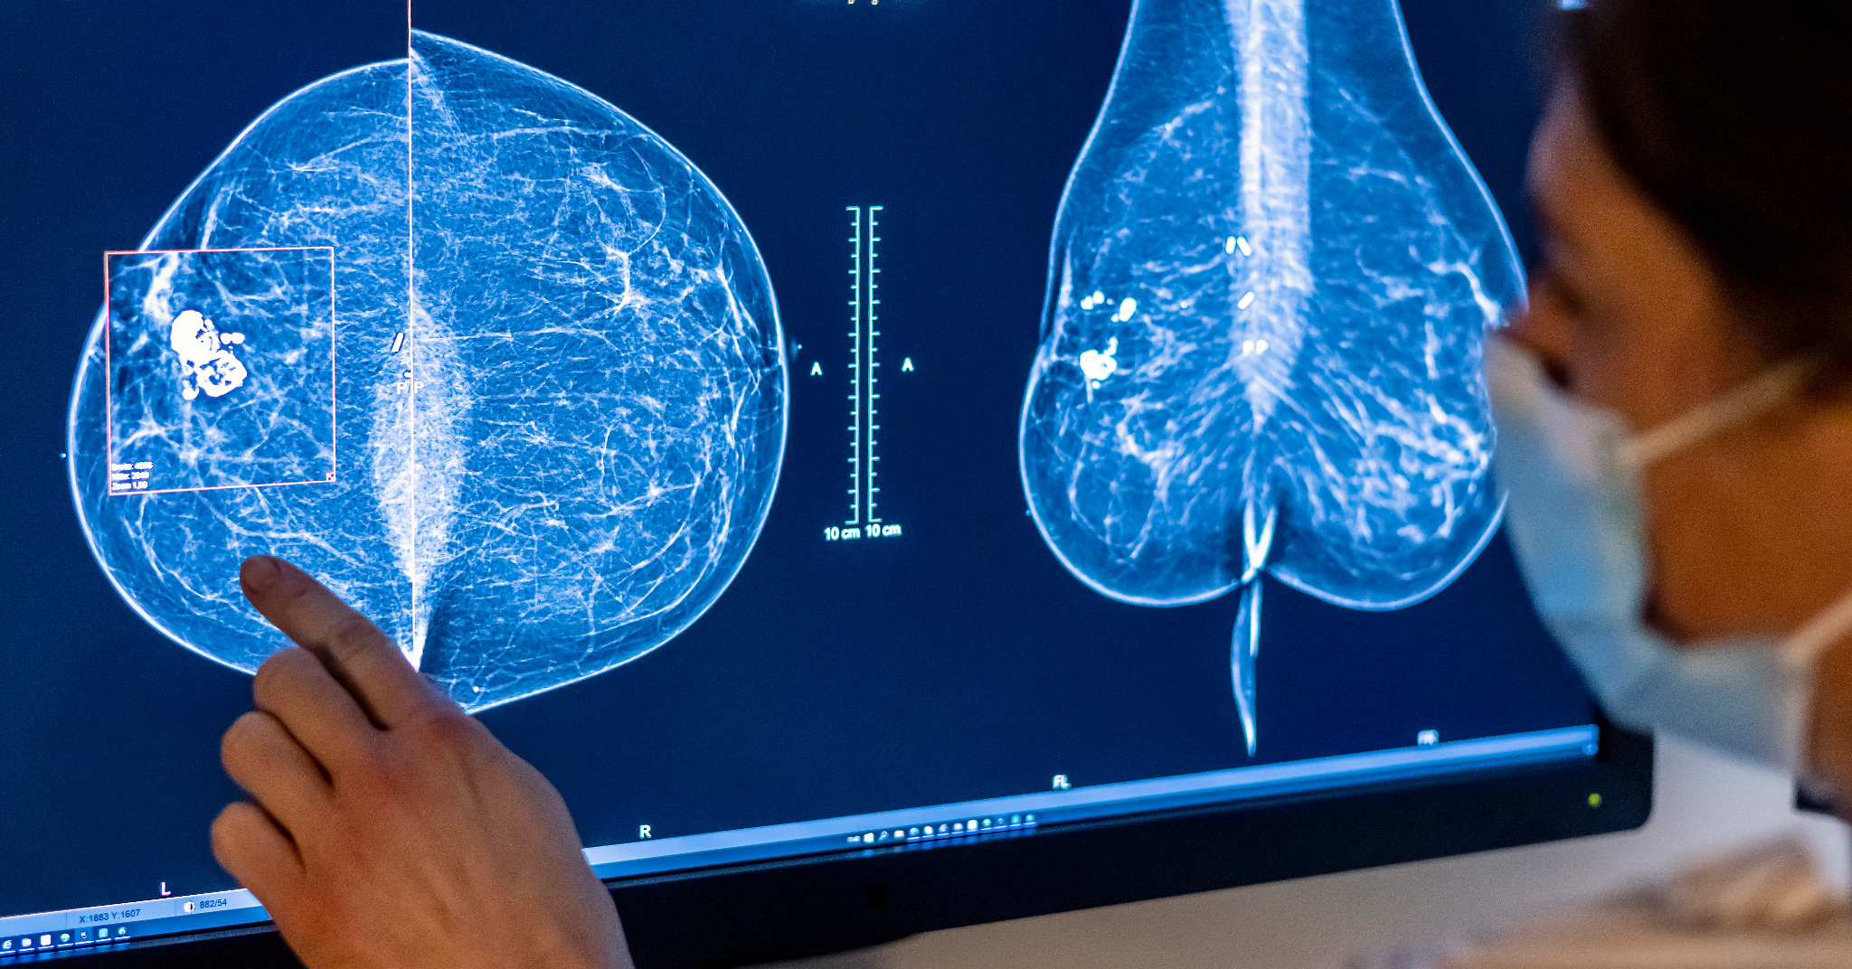
Healthcare & Medicine
AI-Powered Radiology & Diagnostic Imaging Computer vision algorithms analyze medical images (X-rays, CT scans, MRIs) to detect anomalies with higher speed and accuracy than human radiologists.
Use Case: Detecting early-stage tumors, fractures, or neurological abnormalities.
Google Health (DeepMind) has developed AI models that outperform human experts in spotting breast cancer in mammograms, reducing both false positives and false negatives.
Source

Slide 3
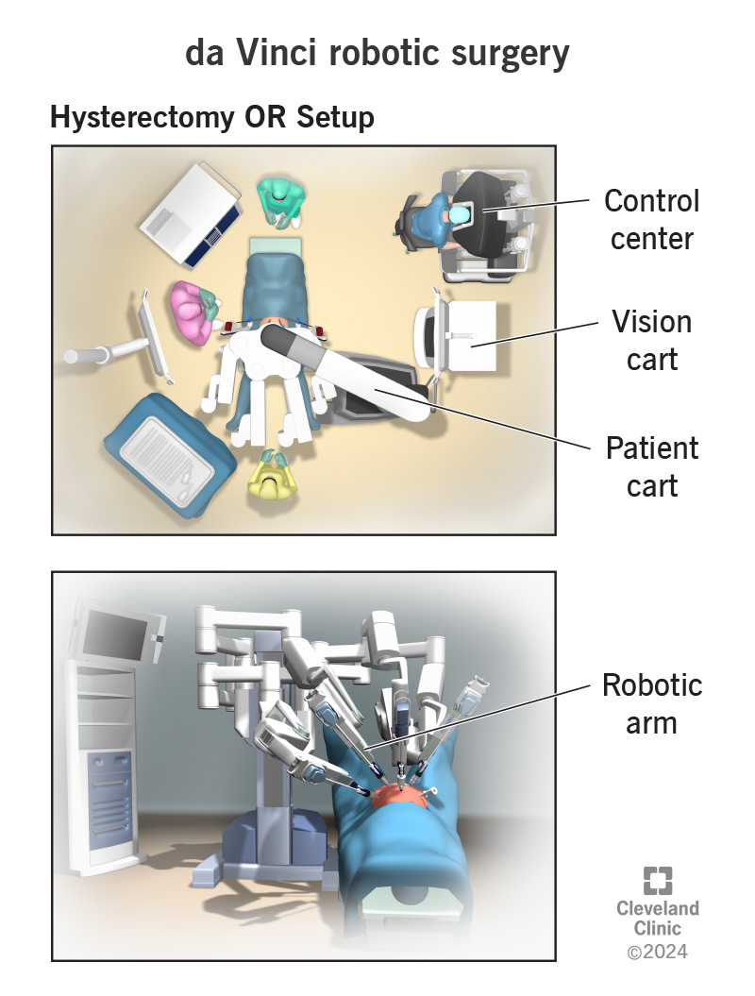
Healthcare & Medicine
Surgical Robotics & Navigation During complex surgeries, computer vision helps robotic systems "see" inside the body, guiding the surgeon’s tools to precise locations and avoiding critical nerves or blood vessels.
Use Case: Overlaying augmented reality (AR) data on a surgeon's live view during spinal or neurosurgery.
Intuitive Surgical’s Da Vinci systems use 3D high-definition vision to allow surgeons to operate with enhanced vision, precision, and control.
Source

Slide 4
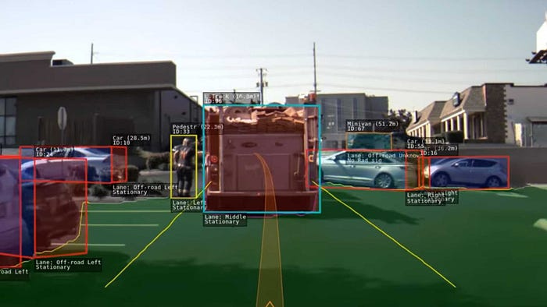
Automotive & Transportation
Autonomous Driving & Advanced Driver Assistance Systems (ADAS) Vehicles process video feeds from multiple cameras in real-time to understand the environment, detect lanes, read signs, and avoid obstacles.
Use Case: Lane centering, adaptive cruise control, and full self-driving capabilities.
Tesla Autopilot uses a vision-only approach (replacing radar) to build a 3D vector space of the road, identifying cars, pedestrians, and traffic lights instantaneously.
Source

Slide 5
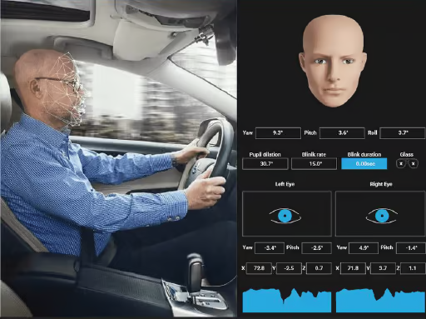
Automotive & Transportation
Driver Monitoring Systems (DMS) Interior-facing cameras analyze the driver’s facial expressions, eye gaze, and head position to detect drowsiness or distraction.
Use Case: Alerting a driver who is falling asleep or looking at their phone for too long.
Subaru’s DriverFocus system uses facial recognition to identify signs of driver fatigue and provides audio/visual alerts to refocus attention.
Source

Slide 6
Retail & E-Commerce
Cashier-less "Just Walk Out" Shopping Stores use ceiling-mounted cameras and sensor fusion to track customers as they move through the store, detecting exactly what they pick up or put back on the shelf.
Use Case: Eliminating checkout lines; the customer's account is automatically charged when they leave.
Amazon Go stores pioneered this technology, allowing a seamless "grab and go" experience without scanning a single barcode.
Source

Slide 7
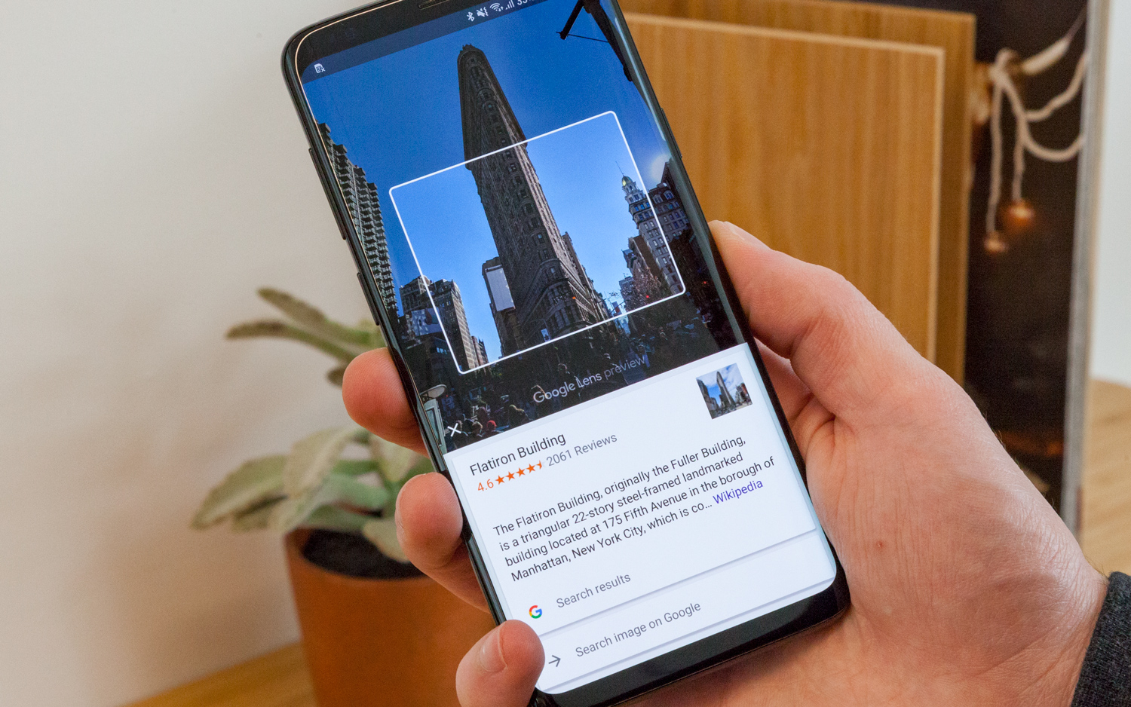
Retail & E-Commerce
Visual Search & Product Discovery E-commerce apps allow users to take a photo of an item (like a pair of shoes or a piece of furniture) and instantly find that product or similar items in an online catalog.
Use Case: Finding a product when you don't know its name or brand.
Pinterest Lens and Google Lens allow users to snap photos of real-world objects to find purchase links and design inspiration.
Source

Slide 8
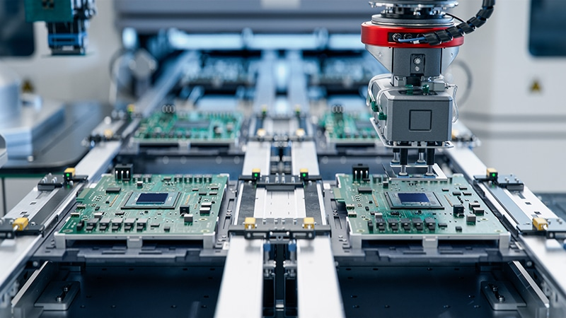
Manufacturing & Logistics
Automated Optical Inspection (AOI) In factories, high-speed cameras inspect products on the assembly line to spot microscopic defects, missing components, or labeling errors that human eyes might miss.
Use Case: Inspecting printed circuit boards (PCBs) or automotive parts for quality assurance.
Foxconn uses automated vision systems to inspect smartphone components during assembly, ensuring zero defects in millions of devices.
Source

Slide 9
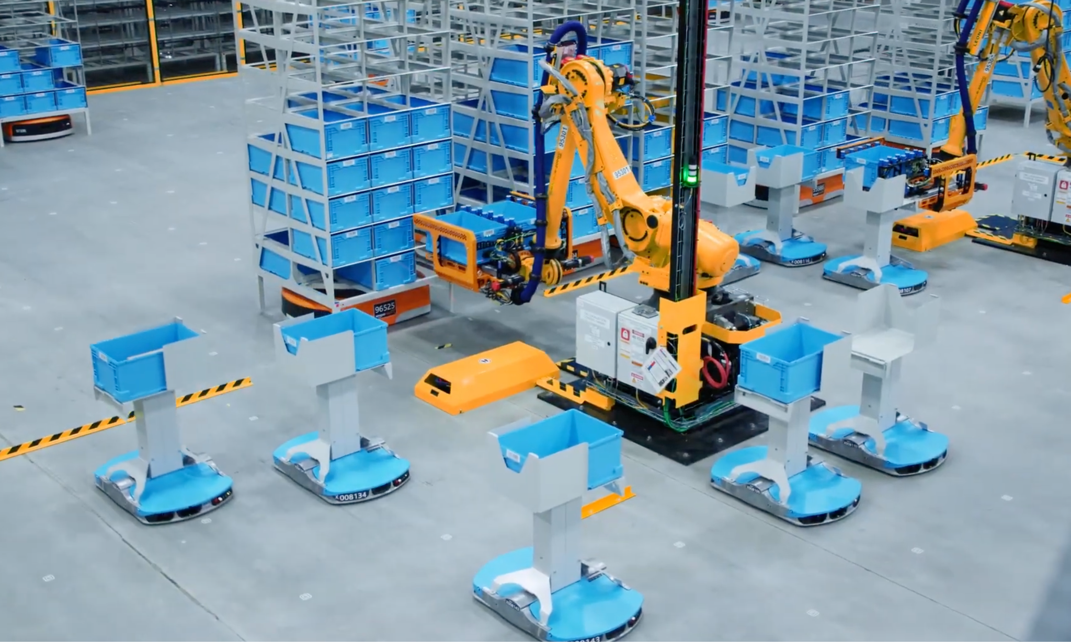
Manufacturing & Logistics
Warehousing Robotics & Sorting Robots equipped with vision systems navigate dynamic warehouse environments, identify packages, and sort them for shipping based on size, shape, and label data.
The Use Case: High-speed parcel sorting and autonomous pallet moving.
Amazon Robotics (formerly Kiva) uses vision to navigate thousands of drive units on warehouse floors, moving inventory pods to human pickers efficiently.
Source

Slide 10
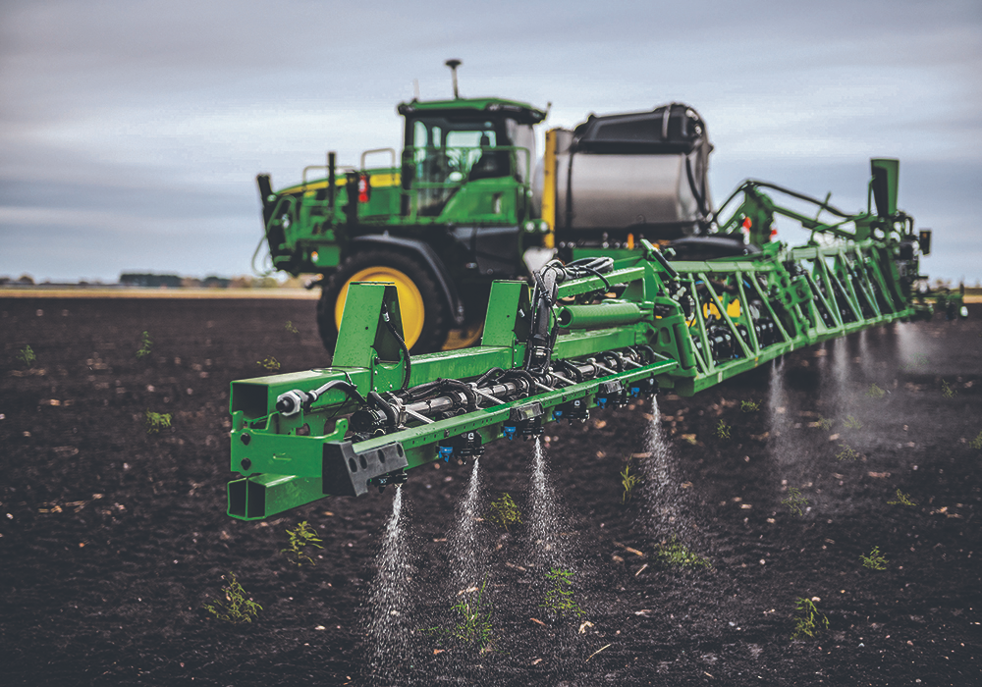
Agriculture
Precision Agriculture (Weed & Crop Monitoring) Tractors and drones equipped with cameras analyze fields to distinguish between crops and weeds, spraying herbicide only on the weeds rather than blanket-spraying the whole field.
Use Case: Reducing chemical usage and cost while maximizing crop yield.
John Deere’s "See & Spray" technology uses computer vision to detect weeds in real-time and target them with precise nozzles.
Source

Slide 11
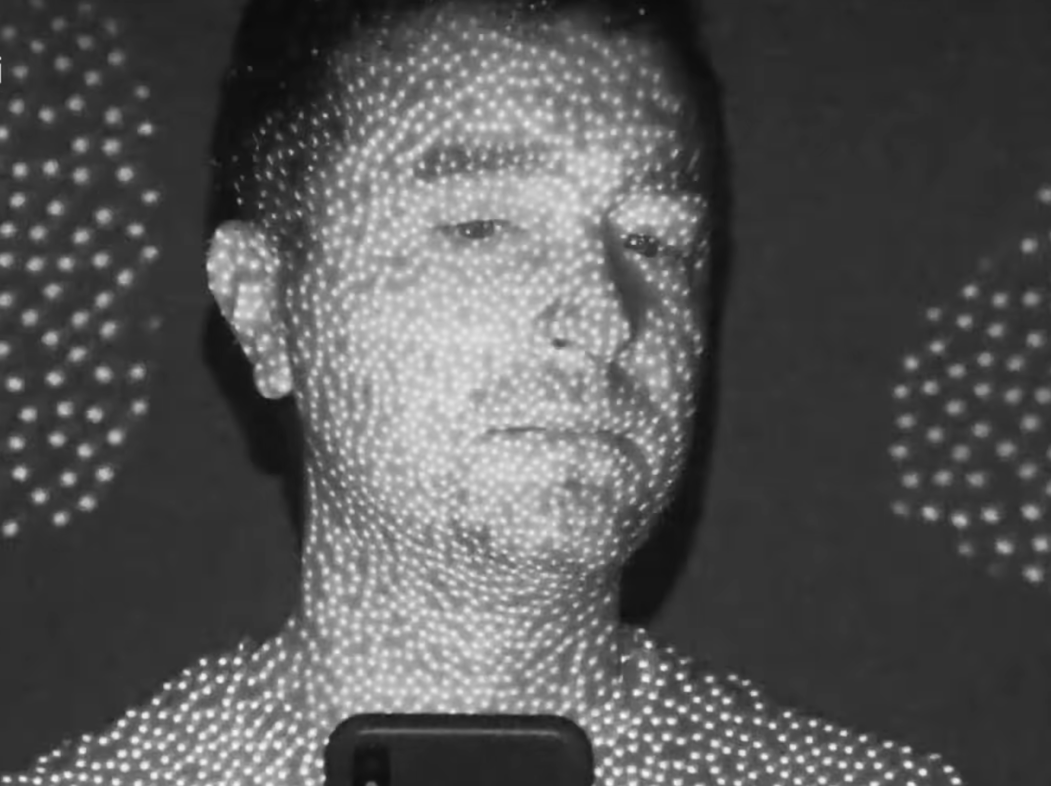
Security & Identity
Facial Recognition for Access Control Systems map facial features to verify identity, replacing passwords or physical badges for entry into secure locations or devices.
Use Case: Unlocking smartphones, passing through airport security (biometric boarding), or time-and-attendance tracking.
Apple FaceID projects thousands of infrared dots onto the user's face to create a 3D depth map, securely unlocking iPhones and authorizing payments.
Source

